Slide 1

A Brief Introduction to SDN
V0.1
Notes:
What does it mean to say software-driven? For large network equipment vendors, software cost already accounts for 90% of R&D cost.

Slide 2
Outline
What is and why SDN?
Notes:
At a high level, abstraction is to hide issues that others do not want to or hard to do things.

Slide 3
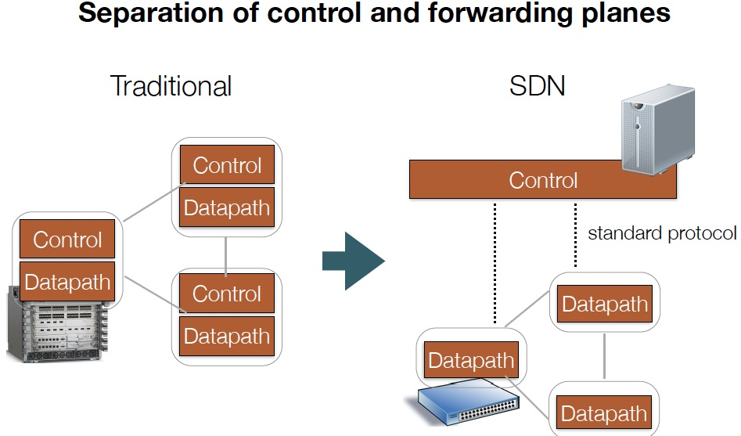
What is SDN?
Notes:
FLP, Arrow’s Impossibility Theorem. Failure of distributed computing.

Slide 4
Why SDN (Theory)?
Distributed computing is hard
FLP Impossibility Theorem
Arrow’s Impossibility Theorem
Achieved good design for only some simple tasks (e.g., leader election, shortest path), but we need to handle more complexity in many settings.

Slide 5
Why SDN (Architecture Theory)?
“Modularity based on abstraction is the way things get done.” -- Barbara Liskov
Major advance in many fields of computer science is based on simple, powerful abstractions.
A major lacking of networking is not enough good abstractions in network control.
Notes:
Hide details; Provide automatic optimization
Theory: Turing machine; systems: DB/relational algebra; OS/Virtual memory/thread; PL: low level language to higher level languages. Networking layer architecture is abstractions for data plane. Major advance is possible if we introduce the right abstractions in the network control plane.

Slide 6

Why SDN (Industry)?
“We are focusing on a market transition involving the move toward more programmable, flexible, and virtual networks… This transition is focused on moving from a hardware-centric approach for networking to a virtualized network environment that is designed to enable flexible, application-driven customization of network infrastructures. -- Cisco Annual Report (pp2), Nov. 2015
Notes:
“The cost to operate networks is too high and growing too fast and you can’t find enough people to manage these things anymore. It’s time for change.” -- Nick Lippis, ONUG /Fidelity, 2013
To appeal to companies looking for more highly customized systems, Cisco has also opened up its software to programmers in new ways, making it easier for clients to write their own apps for Cisco products.
http://www.bloomberg.com/news/articles/2015-11-05/cisco-s-new-ceo-embraces-the-cloud

Slide 7
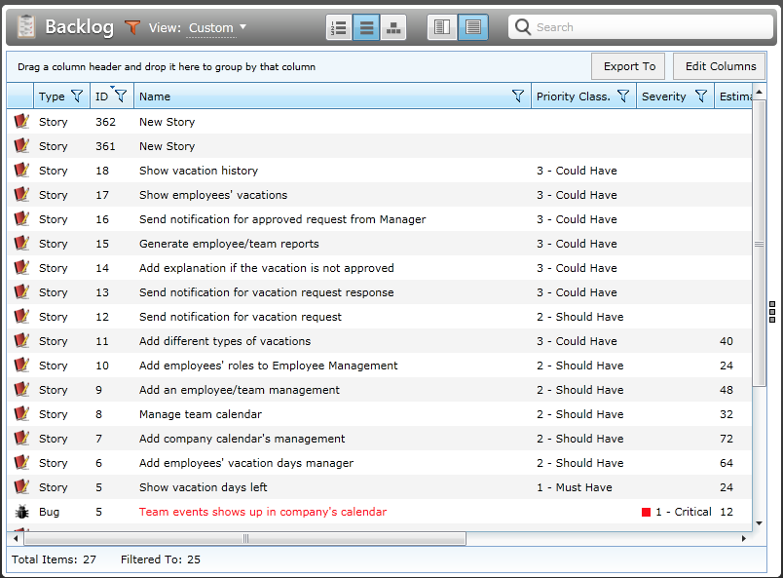
Why SDN (Industry)?
Network customization/feature requests can be a slow process.
Notes:
small (fewer than 1k hosts), medium (1k-10k hosts), large (10k-100k hosts), and
very large (more than 100k hosts) enterprise network

Slide 8
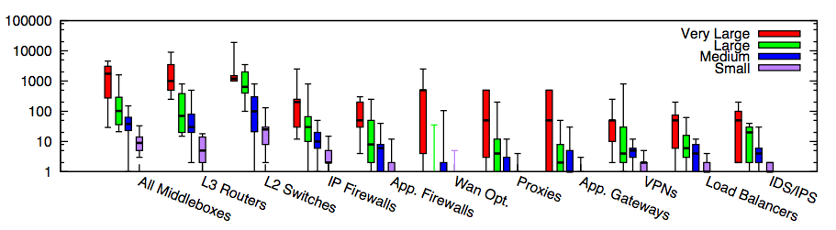
Why SDN or More Programmable Networks (Industry)?
Modern networks contain increasingly more diverse types of equipment
In traditional settings, each type/vendor runs in its own hardware box
Substantial flexibility if more programability
Small: <=1k hosts; Medium: 1k-10k; Large: 10k-100k; Very Large: >= 100k
Source: [Sherry, et. al SIGCOMM’12]
Notes:
为啥呢？因为total ownership cost少。1. 我server买了，3年合同以后可以自行切换。前三年load cisco的virtual router，后三年load juniper的virtual switch。再过三年load palo alto的virutal firewall 2. 设备performance更新，只需要换低层硬件，就可以扩展
Router, switch, firewall merge
Server + software, which include Router, Switch, FT
DC -> Cloud
ENT switch reducing; Cloud increasing
There are more virtual ports than physical ports, where the virtual ports are controlled by x86 software. Where software erodes hardware

Slide 9
Outline
What is and why SDN?
SDN now
Notes:
At a high level, abstraction is to hide issues that others do not want to or hard to do things.

Slide 10
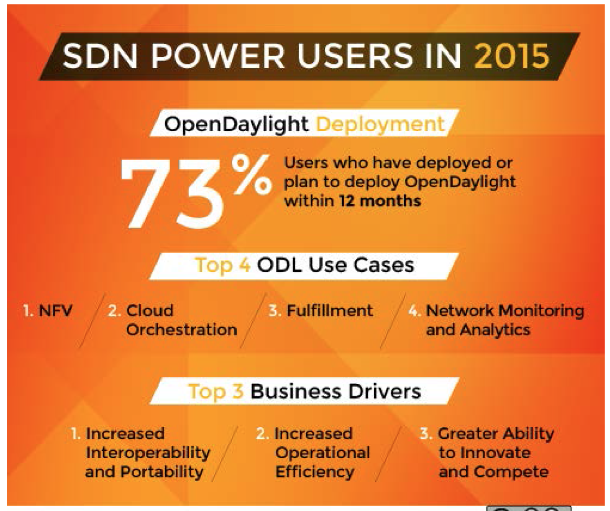
Results of a User Survey
128 Companies responded
31% Telcos/Service Providers
24% Research/Academia
20% Enterprises
10% Services/Consulting
9% Software/Hardware
6% Other
Source: Neela Jacques, July 2015.
Notes:
At a high level, abstraction is to hide issues that others do not want to or hard to do things.

Slide 11
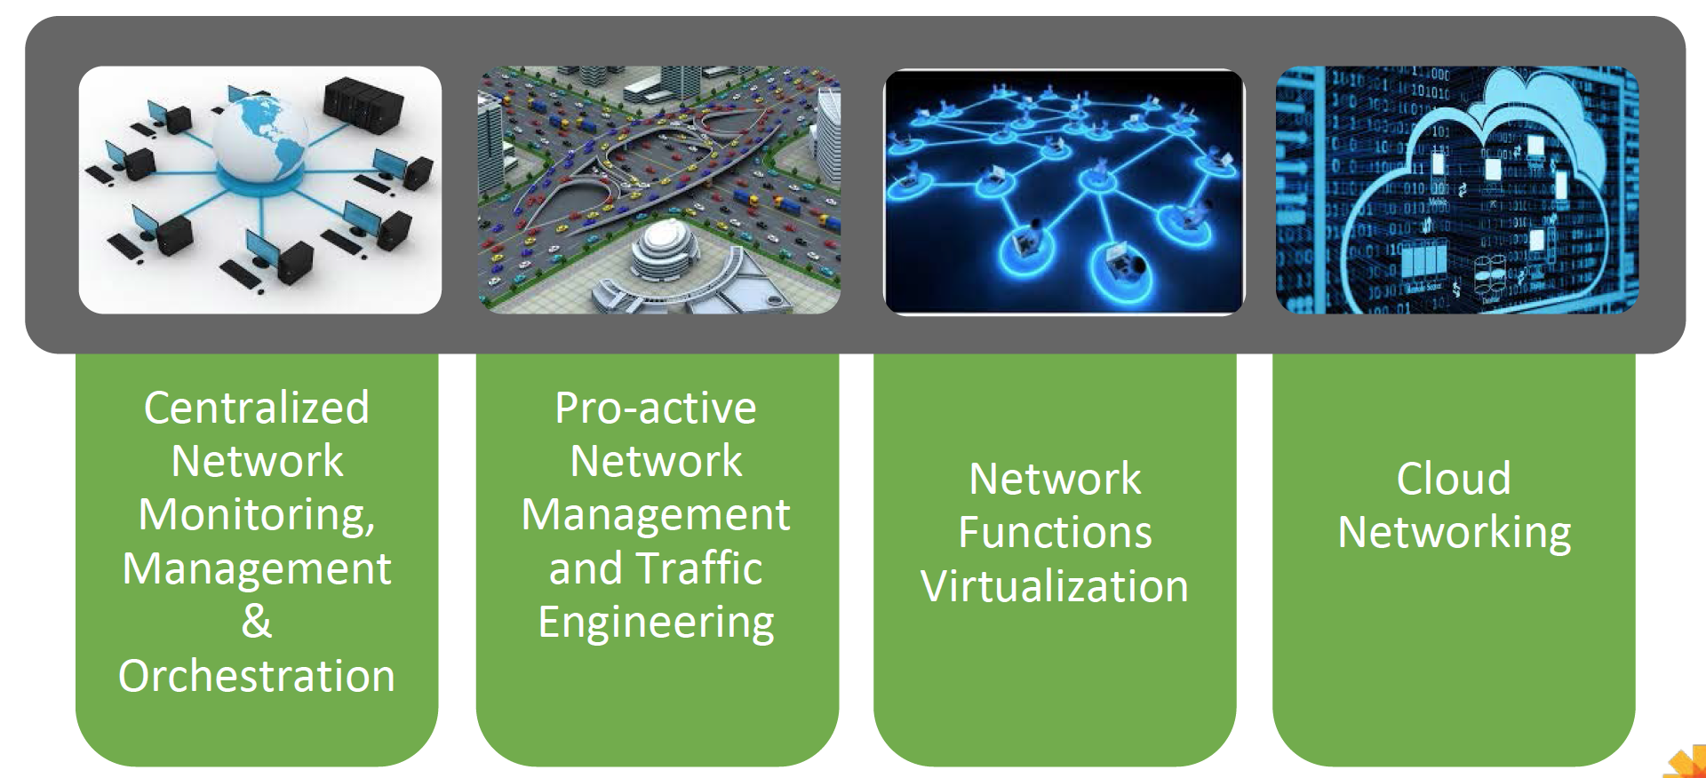
Some Main Use Cases of SDN
Source: Neela Jacques, July 2015.
Notes:
At a high level, abstraction is to hide issues that others do not want to or hard to do things.

Slide 12
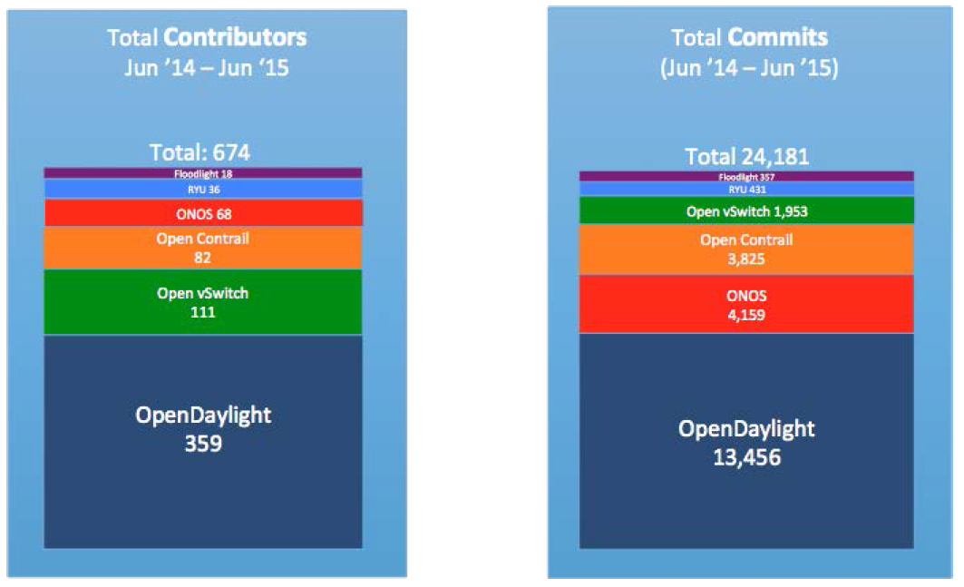
State of Current (Open Source) Players
Source: Neela Jacques, July 2015.

Slide 13
Outline
What is and why SDN?
SDN now
SDN technical components
Keep some key questions in mind while engage
Notes:
At a high level, abstraction is to hide issues that others do not want to or hard to do things.

Slide 14
Key Areas for Abstraction
Three key areas for abstractions [Shenker’11]
Distribution, configuration, forwarding
Notes:
topology

Slide 15
What’s New and Important in SDN
- Network apps, e.g., xxx
- Network programming languages, e.g., Frenetic, Maple, …
- Network OS, e.g., Floodlight, ONOS, OpenDaylight, NOX, Ryu, …)
SNMP
Forces
NetConf RestConf
OpenFlow
OpenFlow1.x OFDPA P4 POP
…
Notes:
OpenFlow receives the most attention. However, Doug Commer from Purdue talk at ONUG’14: the school invented OpenFlow teaches magic…

Slide 16

Key Datapath Question
What should be the data path of network devices?
Flow table
VM/Container

Slide 17
Key Configuration Question
Map<MAC, Location> hostTable; List<ACLItem> acls;
Route f(Packet p) {
hostTable.put(p.ethSrc(), p.ingressPort());
if ( !permit(p, acls) ) return drop;
Location src = p.ingressPort();
Location dst = hostTable.get( p.ethDst() );
Route path = myRoutingAlg(topology(), src, dst);
return path;
}
Declare states
External process may change the state
Access pkt attributes
External process may change the state
Access state
Access state
Access state
Complex computation
Data path can causes state update

Slide 18
Toward High-Level SDN Programming
V0.1
Notes:
What does it mean to say software-driven? For large network equipment vendors, software cost already accounts for 90% of R&D cost.

Slide 19
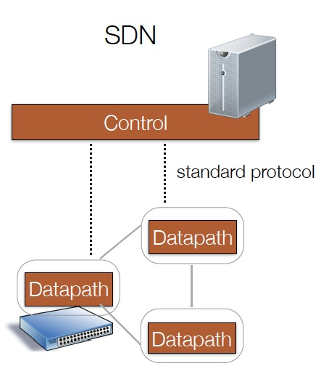
What’s New and Important in SDN
Biggest failure of networking research: not enough good abstractions in network control.
One key benefits of SDN: Better programming abstractions to allow easier, more efficient high-level network control and management.
Notes:
Benefits of abstraction: hide details, automatic instead of manual optimization, hide dynamics, hide resource limitations.

Slide 20
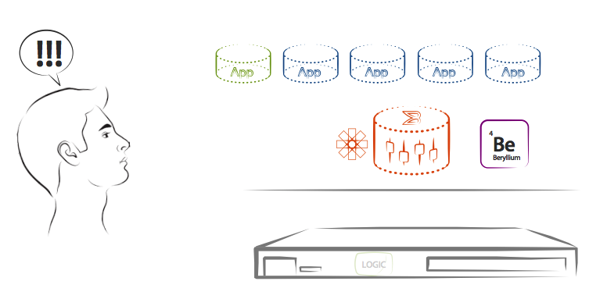
Better Softwarization for Network Programming
Source: Kelly Herrell, SVP, Brocade, 2015.
Notes:
http://events.linuxfoundation.org/sites/events/files/slides/odls15_herrell.pdf

Slide 21
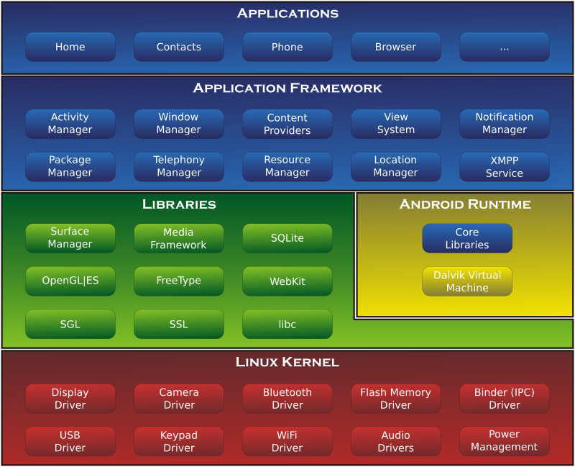
Android: A Potential Analogy
Source: https://en.wikipedia.org/wiki/Android_(operating_system)#/media/File:Android-System-Architecture.svg
21
Notes:
http://events.linuxfoundation.org/sites/events/files/slides/odls15_herrell.pdf

Slide 22
Outline
What and why SDN?
Current SDN programming systems
Notes:
At a high level, abstraction is to hide issues that others do not want to or hard to do things.

Slide 23
State of Current (Open Source) Players
Source: Neela Jacques, July 2015.

Slide 24
OpenDaylight Architecture
Network Devices
Applications
Network Applications Orchestration & Services
Network Devices
Applications
Network Devices
Applications
Controller
NETCONF SERVER
Protocol Plugin
...
Protocol Plugin
App/Service Plugin
...
App/Service Plugin
RESTCONF
Plugins & Applications
Config Subsystem
Model-Driven SAL (MD-SAL)
Controller Platform
Messaging
Data Store
Clustering
Remote Controller Instance
Remote Controller Instance
Source: Ed Warnicke, July 27, 2015.
24

Slide 25
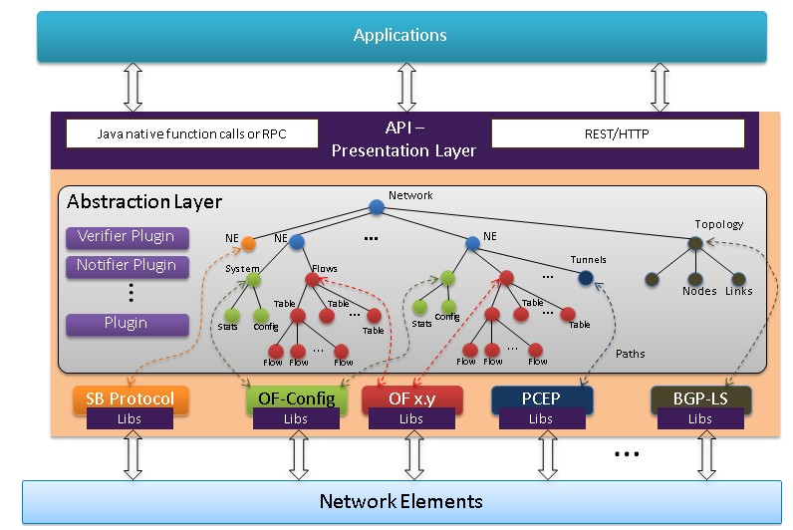
OpenDaylight Architecture
https://wiki.opendaylight.org/view/OpenDaylight_Controller:Architectural_Framework

Slide 26
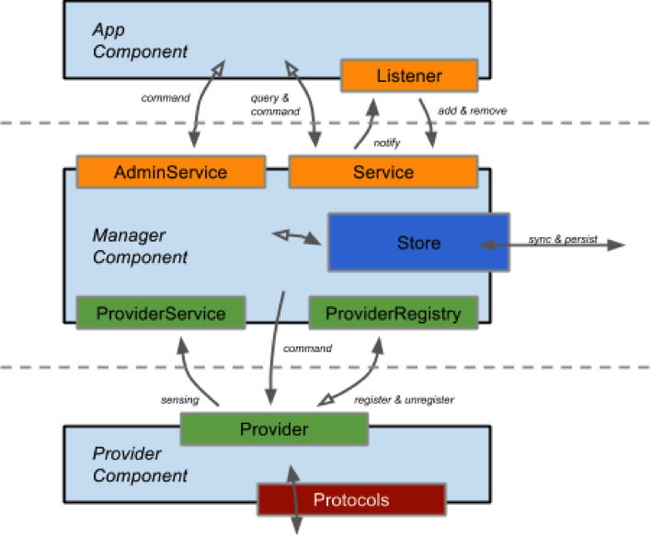
ONOS Architecture
https://wiki.onosproject.org/display/ONOS/System+Components
Notes:
http://api.onosproject.org/1.1.0/org/onosproject/store/Store.html DeviceStore, HostStore, LinkStore, TopologyStore collect info from below
FlowRuleStore supports forwarding abstractions
IntentStore

Slide 27

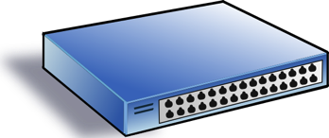
An Abstract View: Focus of Current SDN Systems is Data Store
logically centralized data store
Network View
Service/ Policy
NE Datapath
NE Datapath

Slide 28

What is Missing?
Program
logically centralized data store
Network View
Service/ Policy
NE Datapath
NE Datapath

Slide 29
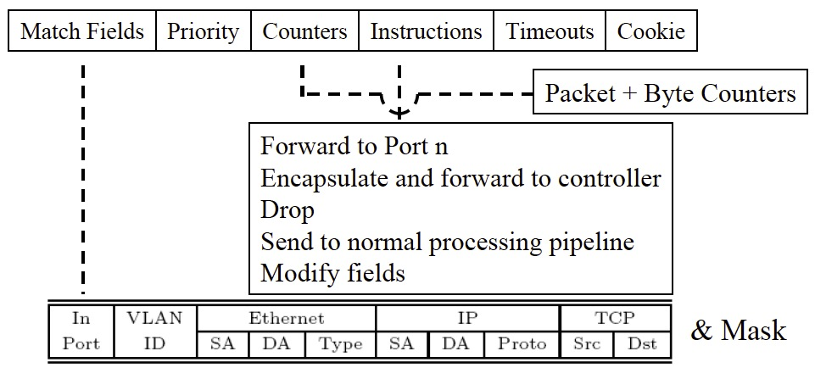
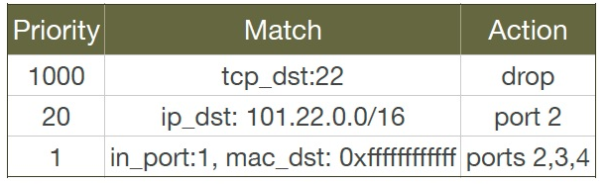
Datapath Model
Low-level TCAM based computing model with limited resources

Slide 30
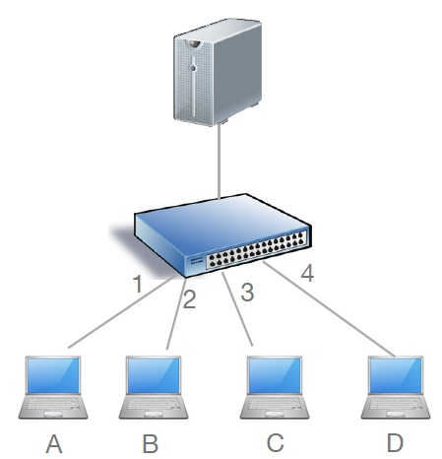
Simple Controller Program
nextHop = {A:1,B:2,C:3,D:4}
def onPacketIn(p):
if 22 == p.tcp_dst: drop
else: forward([nextHop(p.eth_dst)])
Notes:
SDN is a recent hot topic. During a recent NSF panel, many proposals are on SDN. A common feedback is if a propsal can be related with SDN.

Slide 31
Controller Program with Flow Table Management
nextHop = {A:1,B:2,C:3,D:4}
def onPacketIn(p):
if 22 == p.tcp_dst: drop
installRule({‘match':{'tcp_dst':22}, ‘action’:[]})
else: forward([nextHop(p.eth_dst)])
installRule({‘match’: {‘eth_dst’:p.eth_dst, ’tcp_dst’!=22},
‘action’:[nextHop(p.eth_dst)]})
Notes:
SDN is a recent hot topic. During a recent NSF panel, many proposals are on SDN. A common feedback is if a propsal can be related with SDN.

Slide 32
Controller Program with Flow Table Management
nextHop = {A:1,B:2,C:3,D:4}
def onPacketIn(p):
if 22 == p.tcp_dst: drop
installRule({‘priority’:1, ‘match’:{'tcp_dst':22}, ‘action’:[]})
else: forward([nextHop(p.eth_dst)])
installRule({‘priority’:0, ‘match’: {‘eth_dst’:p.eth_dst},
‘action’:[nextHop(p.eth_dst)]})
Notes:
SDN is a recent hot topic. During a recent NSF panel, many proposals are on SDN. A common feedback is if a propsal can be related with SDN.

Slide 33
Example
Switch
EthDst:A,
TcpDst:80
{`priority`:0,’match’:{‘eth_dst’:A},'action':[1]}
EthDst:A,
TcpDst:22
Controller
def onPacketIn(p):
if 22 == p.tcp_dst: drop
installRule({`priority`:1,’match’:{‘tcp_dst':22},'action':[]})
else:
installRule({`priority`:0,’match’:{‘eth_dst’:p.eth_dst},
'action':[nextHop(p.eth_dst)]})
forward([nextHop(p.eth_dst)])
Notes:
Unfortunately, this program has a bug. To see where the program goes wrong, let’s watch what happens when we connect this controller to a single switch and let two packets arrive. Both packets have destination mac A. The red packet is to TCP destination 80, while the green packet is to TCP destination 22. When the red packet arrives, the switch has an empty flow table and sends the packet to the controller. The controller determines that the packet should be forwarded to the next hop, and installs the appropriate rule. The red packet returns to the switch and moves onward. Now, the port 22 packet arrives at the switch, and instead of being dropped or sent to the controller, it matches the low priority rule for Ethernet destination A and is therefore forwarded onward. This violates the user’s intentions and may represent a security violation.

Slide 34
Approach I (OVS): Using Exact Match
nextHop = {A:1,B:2,C:3,D:4}
def onPacketIn(p):
if 22 == p.tcp_dst: drop
installRule({‘priority’:1, ‘match’:exactMatch(p), ‘action’:[]})
else: forward([nextHop(p.eth_dst)])
installRule({‘priority’:0, ‘match’:exactMatch(p),
‘action’:[nextHop(p.eth_dst)]})
Notes:
SDN is a recent hot topic. During a recent NSF panel, many proposals are on SDN. A common feedback is if a propsal can be related with SDN.

Slide 35
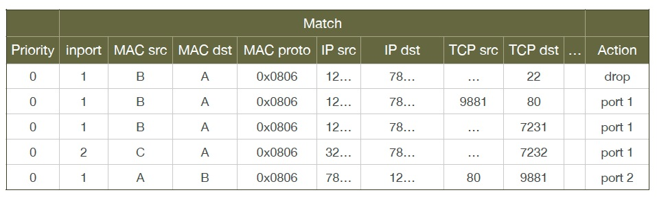
Problems of Approach I
Each new TCP flow delayed for flow setup (10-100 ms)
Number flow table rules may exceed capacity (typically a few thousand)

Slide 36
Approach 2: Declarative Policy Languages
Probably the most well-known is Pyretic [NSDI’13]
if_(match(dstport(22)), drop,
if_(match(dstmac=EthAddr(a)), fwd(1),
if_(match(dstmac=EthAddr(b)), fwd(2),
if_(match(dstmac=EthAddr(c)), fwd(3),
if_(match(dstmac=EthAddr(d)), fwd(4),
flood() )))))
Notes:
SDN is a recent hot topic. During a recent NSF panel, many proposals are on SDN. A common feedback is if a propsal can be related with SDN.

Slide 37
Outline
What and why SDN?
Current SDN programming systems
Algorithmic SDN programming
Notes:
At a high level, abstraction is to hide issues that others do not want to or hard to do things.

Slide 38
Goal
Can we let programmers write the most obvious (hence data path independent) code:
… and automatically generate highly-optimized device data path flow tables?
def onPacketIn(p) if 22 == p.tcp_dst: drop
else: forward([nextHop(p.eth_dst)])
Notes:
SDN is a recent hot topic. During a recent NSF panel, many proposals are on SDN. A common feedback is if a propsal can be related with SDN.

Slide 39
Big Picture: Before
Step 1. Make Decisions
User Level
Step 2. Generate Rules
Controller Library
Under the hood
Switches
Notes:
So today, Openflow programmers are responsible for deciding both how to forward packets and how to configure flow tables. We observe that programmers will be motivated by performance goals to use wildcard rules and that reasoning about wildcard rules is complex and introduces a substantial risk of misconfiguration.

Slide 40
Big Picture: After
User Level
Step 1. Make Decisions
Step 2. Generate Rules
OF Controller Library
Under the hood
OF Switches
Notes:
Therefore, we ask whether it is possible to fully automate the generation of high quality flow tables, thereby removing this task from the programmer’s responsibility, simplifying their programs and eliminating this source of errors.
We call the remaining part of the user’s program, an “algorithmic policy”.

Slide 41
Algorithmic SDN Programming Abstraction: User View
Decision function in a general purpose language that describes how a packet should be routed, not how flow tables are configured
Written in a familiar language such as Java, Python, or Haskell.
Conceptually invoked on every packet entering the network:
f: packet route
Notes:
...
Where packet provides access to packet attributes, env provides access to environment state, such as topology and host locations, and the route can be a unicast route, a null route or a multicast route.
...

Slide 42
Example Algorithmic Policy in Java
Route f(Packet p) {
if (p.tcpDstIs(22))
return null();
else {
Location sloc = hostTable(p.ethSrc());
Location dloc = hostTable(p.ethDst());
Route path = myRoutingAlg(topology(), sloc,dloc);
return path;
}
}
Does not specify anything on flow tables!
Notes:
Here is an example algorithmic program, written in Java.
Explain program.
Note that the program does not specify flow table configuration.
So the programming model makes the programmer’s life easy: just take a packet and say what to do with it.

Slide 43
Outline
What and why SDN?
Current SDN programming systems
Algorithmic SDN programming
Programming model
Maple/Basic
Notes:
At a high level, abstraction is to hide issues that others do not want to or hard to do things.

Slide 44
Maple: Basic Idea
Although the decision function f does not specify how flow tables are configured, if for a given decision (e.g., drop), we know the dependency of the decision, we can construct the flow table.
Notes:
...
Where packet provides access to packet attributes, env provides access to environment state, such as topology and host locations, and the route can be a unicast route, a null route or a multicast route.
...

Slide 45
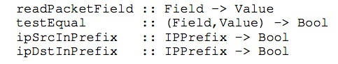
Maple/Basic Idea: Minimal Abstraction
Only requirement: Programs use simple library to access pkt attributes:
Library provides both convenience and importantly, decision dependency!
Notes:
- Switches have limited TCAM capacity for rules; hence, craft rule sets to optimize TCAM utilization.
- Generated rules may become invalid when network or policy state changes. Need to detect and repair inconsistency with minimal disruption.
- Some policies are inherently hard to distribute and generate many central executions.
On the other hand implementing algorithmic policies is challenging.
We know that naive solutions -- process every packet at controller or use only exact match rules -- perform poorly.
Static analysis to determine layout of flow tables is possible, but has drawbacks; in particular static analysis of general purpose language programs is typically conservative. Furthermore, relying on static analysis will cause the system to become substantially dependent on the source language in which we write algorithmic policies.

Slide 46
Maple/Basic in ODL: Calling Diagram
XXX Draw the calling sequence diagram
Notes:
On the other hand implementing algorithmic policies is challenging.
We know that naive solutions -- process every packet at controller or use only exact match rules -- perform poorly.
Static analysis to determine layout of flow tables is possible, but has drawbacks; in particular static analysis of general purpose language programs is typically conservative. Furthermore, relying on static analysis will cause the system to become substantially dependent on the source language in which we write algorithmic policies.

Slide 47
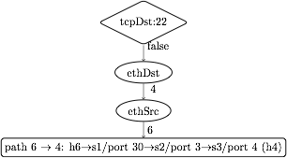
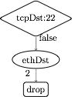
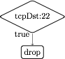
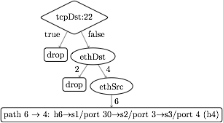
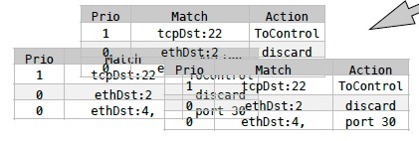
Dynamic Tracing: Abstraction to Flow Tables
1. Observes decision dependency of f on pkt attributes.
2. Builds a trace tree (TT), a general, partial decision tree representation of f.
3. Compile trace tree to generate flow tables (FTs).
Notes:
Instead, we introduce Maple, a system that implements algorithmic policies using a fully dynamic compilation method and which does not depend on the source language used to express the algorithmic policy.
Maple works by repeatedly executing the user’s algorithmic policy f on packets entering the network, generalizing the outcome to other packets by observing traces of data accesses made during the execution.
Maple then accumulates these traces into a trace tree, which is a partial decision tree of the input algorithmic policy, f.
Finally, Maple compiles flow tables (FTs) for all the switches in the network from the trace tree. The compilation is done so that packets for which Maple has not yet successfully inferred a forwarding decision are sent back to the controller to ensure that Maple continues to execute f and refine its trace tree.

Slide 48
Policy
EthSrc:1,
EthDst:2,
TcpDst:80
Route f(Packet p) {
if (p.tcpDstIs(22))
return null();
else {
Location sloc =
hostTable(p.ethSrc());
Location dloc =
hostTable(p.ethDst());
Route path =
myRoutingAlg(
topology(),sloc,dloc);
return path;
}
}
Assert: TcpDst==22
false
Read: EthSrc
1
Read: EthDst
2
path1
Notes:
We use the example Java algorithmic policy to illustrate the tracing method. Suppose Maple executes the algorithmic policy on a packet with Ethernet source 1, Ethernet dest 2 and tcp destination 80. As the packet moves through the policy, Maple collects a trace of the execution.
When this packet arrives at the check on tcp destination, Maple records the assertion, and its outcome. In this case, the outcome is false. The program proceeds to the else branch, where it reads the source and destination addresses, both of which Maple logs. Finally, the program returns the computed path.

Slide 49
Policy
Trace Tree
EthDst:1,
TcpDst:22
Route f(Packet p) {
if (p.tcpDstIs(22))
return null();
else {
Location sloc =
hostTable(p.ethSrc());
Location dloc =
hostTable(p.ethDst());
Route path =
myRoutingAlg(
topology(),sloc,dloc);
return path;
}
}
Assert: TcpDst==22
Assert: TcpDst==22
true
null
true
false
Read: EthSrc
?
1
Read: EthDst
2
path1
Notes:
Maple then uses this trace to begin generating the Trace Tree. In this case, Maple still doesn’t know what will happen if the assertion is true, and it therefore adds a placeholder under the true branch.
Now, if we execute f on a packet to tcp destination 22, the assertion is true, and the packet is dropped. Maple logs this new trace and uses it to refine its Trace Tree, filling in the true branch of the assertion.

Slide 50
Policy
Trace Tree
EthDst:1,
TcpDst:22
Route f(Packet p) {
if (p.tcpDstIs(22))
return null();
else {
Location sloc =
hostTable(p.ethSrc());
Location dloc =
hostTable(p.ethDst());
Route path =
myRoutingAlg(
topology(),sloc,dloc);
return path;
}
}
Assert: TcpDst==22
Assert: TcpDst==22
true
null
true
false
Read: EthSrc
null
1
Read: EthDst
2
path1
Notes:
Maple then uses this trace to begin generating the Trace Tree. In this case, Maple still doesn’t know what will happen if the assertion is true, and it therefore adds a placeholder under the true branch.
Now, if we execute f on a packet to tcp destination 22, the assertion is true, and the packet is dropped. Maple logs this new trace and uses it to refine its Trace Tree, filling in the true branch of the assertion.

Slide 51
Trace Tree Formal Spec
Assert: TcpDst==22
A tree w/ 4 types of nodes
T node: assertion on packet attributes
V node: multi-way branching on a packet attribute
L node: leaf node labeled w/ action
? node: unknown
TT search: traverse tree for a given packet to determine action or no answer
TT correctness: if TT records an answer for a given packet, the answer is the same as the original algrothm
true
false
Read: EthSrc
?
1
Read: EthDst
2
path1
Notes:
On the other hand implementing algorithmic policies is challenging.
We know that naive solutions -- process every packet at controller or use only exact match rules -- perform poorly.
Static analysis to determine layout of flow tables is possible, but has drawbacks; in particular static analysis of general purpose language programs is typically conservative. Furthermore, relying on static analysis will cause the system to become substantially dependent on the source language in which we write algorithmic policies.

Slide 52
Trace Tree => Flow Table
tcpDst ==22
True
False
drop
ethDst
match:{tcpDst==22}
4
2
drop
ethSrc
match:{tcpDst!=22, ethDst:2}
6
port 30
match:{tcpDst!=22, ethDst:4,ethSrc:6}
Notes:
The basic compilation algorithm is actually very simple, and we explain it here in the context of an example trace tree. For simplicity the leaves are labelled with switch-specific actions, such as forward on some ports or drop.
The basic algorithm generates one rule for each execution of f, and each execution of f is stored as a path from the root of the trace tree to a leaf. For example, the right-most path in this tree resulted from an execution that observed that tcpDst!=22 and ethDst==4 and ethSrc==6.
The leaf stores the action and the match condition can be obtained from the path from the root to the leaf. In this case, we would want to match on tcpDst!=22, ethDst==4 and ethSrc==6. Of course, as we described earlier, we cannot match on tcpDst!=22, and so instead we will generate a rule at some higher priority that matches on the condition which we wish to negate. This rule, which we call a “barrier rule” ensures that the rule for the execution which we are considering only fires when the condition is false.
We observe that all the rules that require tcpDst!=22 are under the False branch of the assertion node and all the rules that require tcpDst==22 are under the True branch of the assertion node. Therefore, we can determine the priority level of the barrier rule by first generating rules and assigning priorities to the False branch of the node, and then assigning the priority of the barrier rule to have the next higher priority. Then we can assign priorities to the True branch. Hence, by generating rules in-order from False to True, we can correctly assign priorities to rules.
Finally, since the subtree under the True branch may not completely describe how to handle all tcpDst==22 packets, some packets with tcpDst==22 may fall through to the reach the barrier rule. Therefore, the action for the barrier rule must be ToController, so that we can continue to trace f correctly.

Slide 53
Trace Tree => Flow Table
tcpDst ==22
True
False
drop
ethDst
match:{tcpDst==22}
4
2
drop
ethSrc
match:{tcpDst!=22, ethDst:2}
6
port 30
barrier rule:
match:{tcpDst!=22, ethDst:4,ethSrc:6}
match:{tcpDst==22}
action:ToController
Priority
Notes:
The basic compilation algorithm is actually very simple, and we explain it here in the context of an example trace tree. For simplicity the leaves are labelled with switch-specific actions, such as forward on some ports or drop.
The basic algorithm generates one rule for each execution of f, and each execution of f is stored as a path from the root of the trace tree to a leaf. For example, the right-most path in this tree resulted from an execution that observed that tcpDst!=22 and ethDst==4 and ethSrc==6.
The leaf stores the action and the match condition can be obtained from the path from the root to the leaf. In this case, we would want to match on tcpDst!=22, ethDst==4 and ethSrc==6. Of course, as we described earlier, we cannot match on tcpDst!=22, and so instead we will generate a rule at some higher priority that matches on the condition which we wish to negate. This rule, which we call a “barrier rule” ensures that the rule for the execution which we are considering only fires when the condition is false.
We observe that all the rules that require tcpDst!=22 are under the False branch of the assertion node and all the rules that require tcpDst==22 are under the True branch of the assertion node. Therefore, we can determine the priority level of the barrier rule by first generating rules and assigning priorities to the False branch of the node, and then assigning the priority of the barrier rule to have the next higher priority. Then we can assign priorities to the True branch. Hence, by generating rules in-order from False to True, we can correctly assign priorities to rules.
Finally, since the subtree under the True branch may not completely describe how to handle all tcpDst==22 packets, some packets with tcpDst==22 may fall through to the reach the barrier rule. Therefore, the action for the barrier rule must be ToController, so that we can continue to trace f correctly.

Slide 54
Trace Tree => Flow Table
tcpDst ==22
True
False
drop
ethDst
match:{tcpDst==22}
4
2
drop
ethSrc
match:{tcpDst!=22, ethDst:2}
6
port 30
barrier rule:
match:{tcpDst!=22, ethDst:4,ethSrc:6}
match:{tcpDst==22}
action:ToController
Priority
Notes:
The basic compilation algorithm is actually very simple, and we explain it here in the context of an example trace tree. For simplicity the leaves are labelled with switch-specific actions, such as forward on some ports or drop.
The basic algorithm generates one rule for each execution of f, and each execution of f is stored as a path from the root of the trace tree to a leaf. For example, the right-most path in this tree resulted from an execution that observed that tcpDst!=22 and ethDst==4 and ethSrc==6.
The leaf stores the action and the match condition can be obtained from the path from the root to the leaf. In this case, we would want to match on tcpDst!=22, ethDst==4 and ethSrc==6. Of course, as we described earlier, we cannot match on tcpDst!=22, and so instead we will generate a rule at some higher priority that matches on the condition which we wish to negate. This rule, which we call a “barrier rule” ensures that the rule for the execution which we are considering only fires when the condition is false.
We observe that all the rules that require tcpDst!=22 are under the False branch of the assertion node and all the rules that require tcpDst==22 are under the True branch of the assertion node. Therefore, we can determine the priority level of the barrier rule by first generating rules and assigning priorities to the False branch of the node, and then assigning the priority of the barrier rule to have the next higher priority. Then we can assign priorities to the True branch. Hence, by generating rules in-order from False to True, we can correctly assign priorities to rules.
Finally, since the subtree under the True branch may not completely describe how to handle all tcpDst==22 packets, some packets with tcpDst==22 may fall through to the reach the barrier rule. Therefore, the action for the barrier rule must be ToController, so that we can continue to trace f correctly.

Slide 55
Trace Tree => Flow Table
Simple, classical in-order tree traversal generates flow table rules!
tcpDst ==22
3
1
True
False
2
ethDst
drop
match:{tcpDst==22}
2
4
drop
ethSrc
match:{tcpDst!=22, ethDst:2}
6
port 30
barrier rule:
match:{tcpDst!=22, ethDst:4,ethSrc:6}
match:{tcpDst==22}
action:ToController
Priority
Notes:
The basic compilation algorithm is actually very simple, and we explain it here in the context of an example trace tree. For simplicity the leaves are labelled with switch-specific actions, such as forward on some ports or drop.
The basic algorithm generates one rule for each execution of f, and each execution of f is stored as a path from the root of the trace tree to a leaf. For example, the right-most path in this tree resulted from an execution that observed that tcpDst!=22 and ethDst==4 and ethSrc==6.
The leaf stores the action and the match condition can be obtained from the path from the root to the leaf. In this case, we would want to match on tcpDst!=22, ethDst==4 and ethSrc==6. Of course, as we described earlier, we cannot match on tcpDst!=22, and so instead we will generate a rule at some higher priority that matches on the condition which we wish to negate. This rule, which we call a “barrier rule” ensures that the rule for the execution which we are considering only fires when the condition is false.
We observe that all the rules that require tcpDst!=22 are under the False branch of the assertion node and all the rules that require tcpDst==22 are under the True branch of the assertion node. Therefore, we can determine the priority level of the barrier rule by first generating rules and assigning priorities to the False branch of the node, and then assigning the priority of the barrier rule to have the next higher priority. Then we can assign priorities to the True branch. Hence, by generating rules in-order from False to True, we can correctly assign priorities to rules.
Finally, since the subtree under the True branch may not completely describe how to handle all tcpDst==22 packets, some packets with tcpDst==22 may fall through to the reach the barrier rule. Therefore, the action for the barrier rule must be ToController, so that we can continue to trace f correctly.

Slide 56
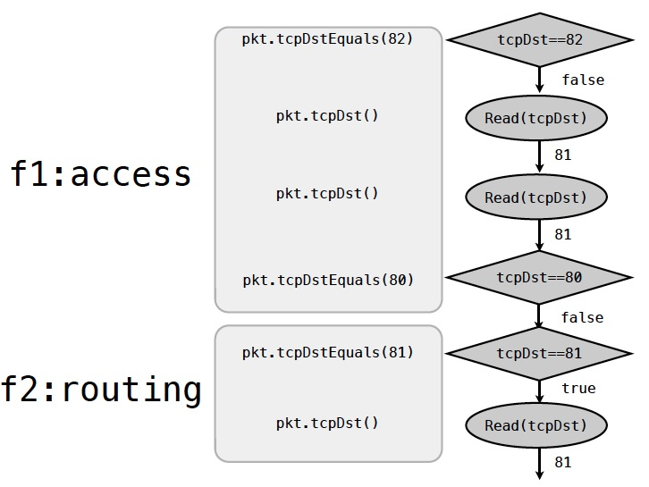
Handling User Inefficiency: Redundant Trace

Slide 57
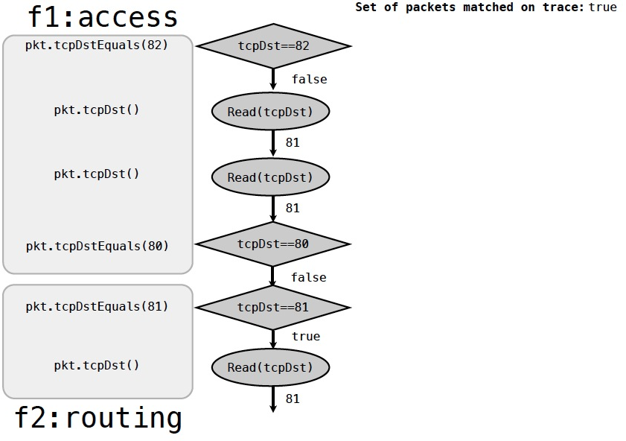
Example: Trace Reduction

Slide 58
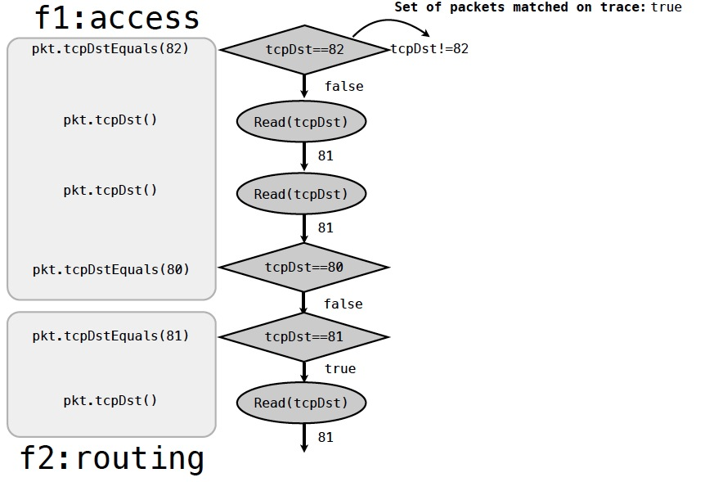
Example: Trace Reduction

Slide 59
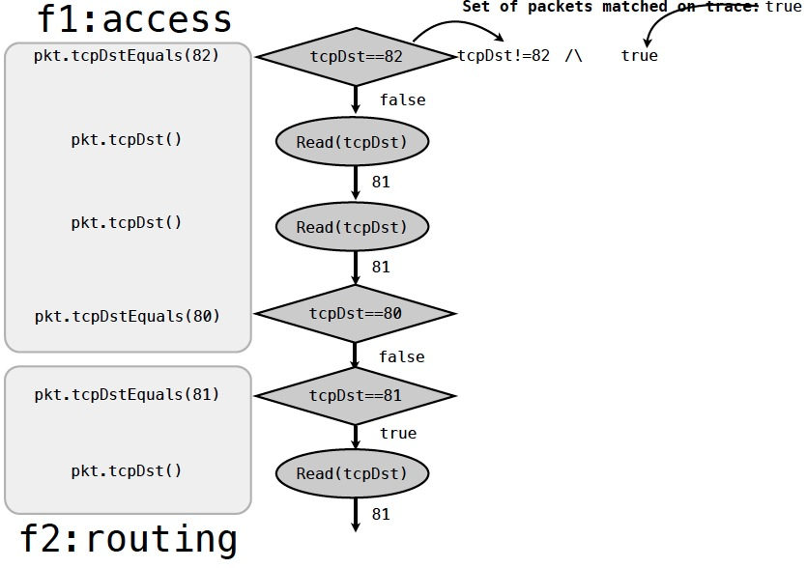
Example: Trace Reduction

Slide 60
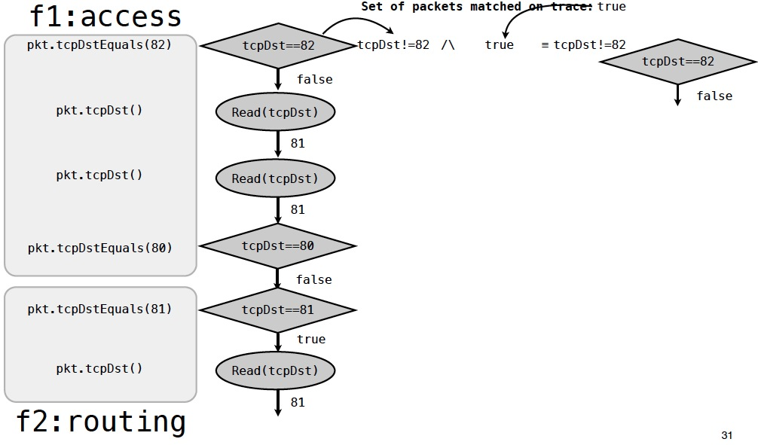
Example: Trace Reduction
Notes:
SDN is a recent hot topic. During a recent NSF panel, many proposals are on SDN. A common feedback is if a propsal can be related with SDN.

Slide 61
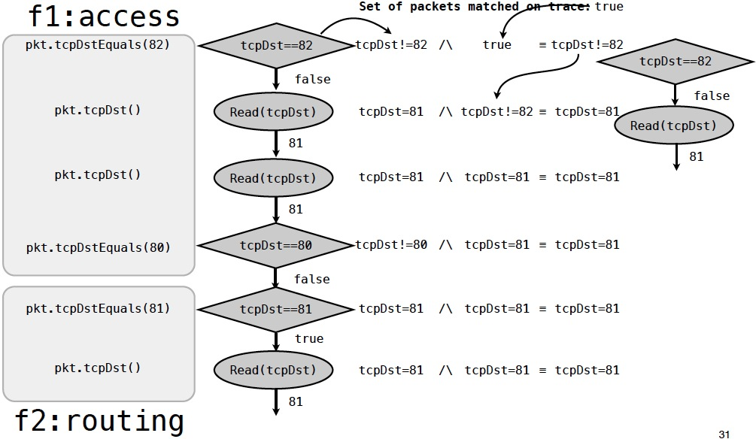
Example: Trace Reduction

Slide 62
Example: Trace Reduction

Slide 63
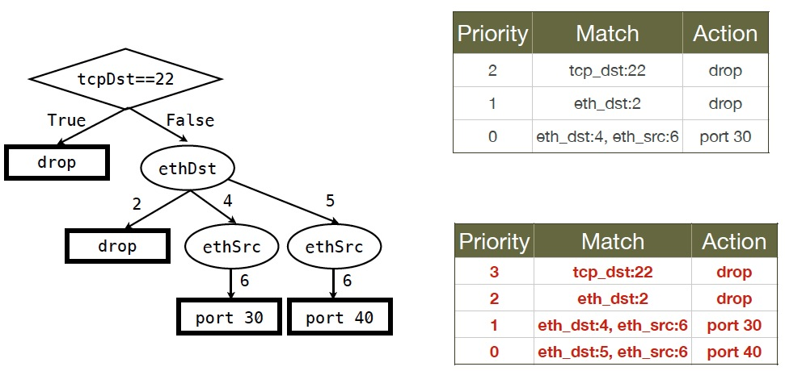
Flow Table Optimization

Slide 64
Flow Table Optimization

Slide 65
Flow Table Optimization

Slide 66
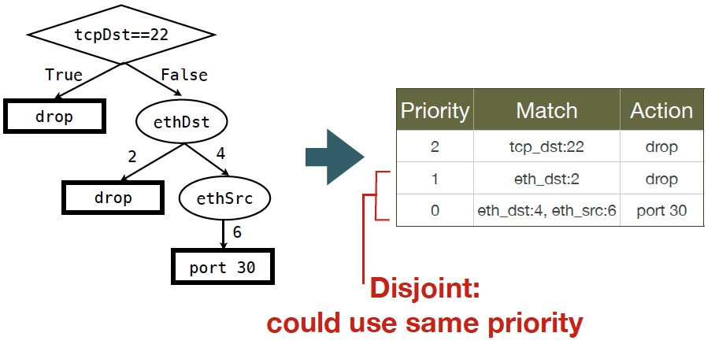
Unnecessary Priority Levels

Slide 67
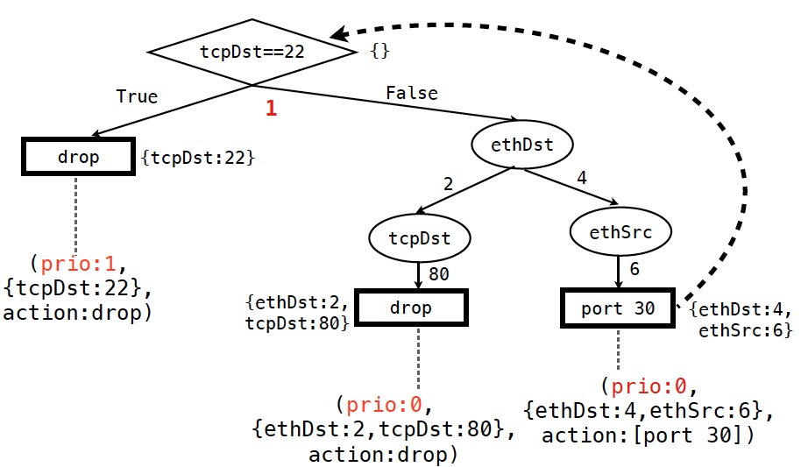
Minimizing Priority Levels: Increasing at T Nodes Only

Slide 68
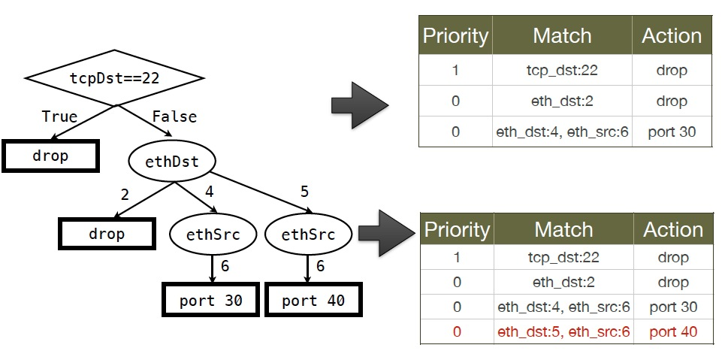
Minimizing Priority Levels: Increasing at T Nodes Only

Slide 69
Minimizing Priority Levels: Increasing at T Nodes Only

Slide 70
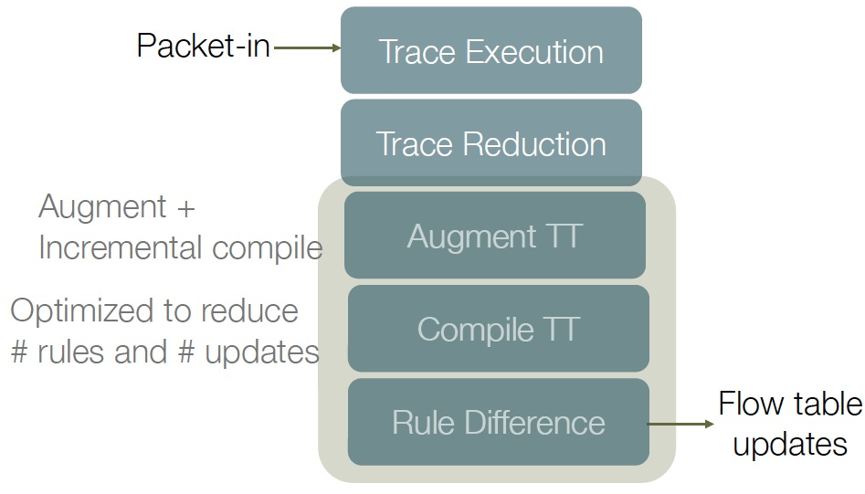
Maple/Basic Runtime

Slide 71
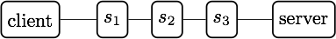
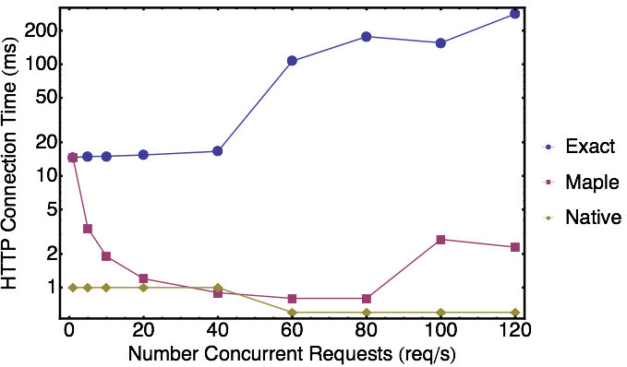
Maple/Basic Evaluation
3 real HP 5406 switches, client on one side, server on the other.
Client performs X HTTP reqs/s using httperf.
Measure average HTTP connection time as X varies.
Compare exact & maple
Exact: up to 282 ms average
Run-time: 1-2 ms: 100x reduction.
Notes:
We measured the effect of using Maple-generated rules in a network using 3 real HP 5406 Openflow-enabled switches arranged in a linear topology. We connect a client and a web server on either side of the switches. The client issues HTTP requests to the web server and we measure the average HTTP connection time as we vary the rate at which HTTP connections are created at the client. We use an algorithmic policy that simple routes traffic based on the source and destination addresses. We compare the performance when using Maple’s rule generation method with the performance when generating only exact match rules and with the native L2 functionality of the switches.
We see that the performance of the exact match controller introduces substantial delay to the HTTP connection time, taking up to 282 ms when 120 requests are issued per second.
On the other hand, the Maple controller achieves a HTTP connection time of 2 ms at 120 requests per second, a 100x improvement. Maple’s performance closely matches that of the native L2 functionality up to about 100 requests per second.

Slide 72
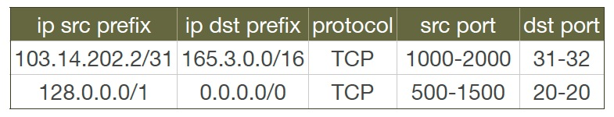
Evaluation: Maple as ACL Compiler
ACLs commonly used in network management
Questions
How does one program ACL using Maple?
How does one combine ACL with other policies, e.g. routing, load balancing?
Notes:
To evaluate Maple, we apply it to an interesting problem: how to implement filter sets, such as access control lists that match on IP prefixes and TCP or UDP port ranges, on Openflow switches. This could be challenging, especially if we also want to solve the problem when the filter sets are combined with other policies, such as routing or load balancing policies.
We solve this problem with Maple by programming a simple filter set interpreter as an algorithmic policy, f.
The policy initially loads a filter set from a file, and then handles packets by just naively using the semantics of the filter set: iterate over filters in the filter set, test each filter against the packet and return an action based on the first matching filter.

Slide 73
Maple Example: ACL+Routing
void insert(ACLItem acl, int pos, List<ACLItem> acls) {
acls.add(pos, acl);
}
void delete(int pos, List<ACLItem> acls) {
acls.remove(pos);
}
boolean permit(Packet p, List<ACLItem> acls) {
for (ACLItem item : acls) {
if ( match(p, item) ) {
return item.action == PERMIT;
} }
return false;
}
List<ACLItem> acls;
Route f(Packet p) {
if ( ! permit(p, acls) ) {
return null();
}
Location sloc = hostTable(p.ethSrc());
Location dloc = hostTable(p.ethDst());
Route path = myRoutingAlg(topology(),sloc,dloc);
return path;
}

Slide 74
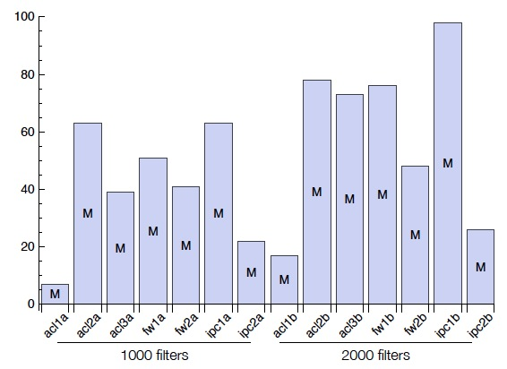
Benchmarking Compiler Quality
98 priority levels for 2000 IPC rules
Benchmark: Classbench filter sets and packet traces for 3 filter set types - ACL, FW, IPC - and two sizes - 1000 and 2000 filters per filter set.
Metric: #priority levels used
Only 9 priority levels for 1000 rules
Notes:
In this graph we show the number of priority levels used by the Maple-generated rules for the same filter sets. We see that Maple often uses very few priority levels. For example, acl1a uses just 9 priorities for roughly 1000 rules. Some policies cause Maple to use substantially more priorities - for example acl2b required 120 priorities for nearly 2000 rules.

Slide 75
Outline
What and why SDN?
Current SDN programming systems
Algorithmic SDN programming
Programming model
Maple/Basic (aka Maple 1.0)
Maple/auto-state-update (aka Maple 1.5)
Notes:
At a high level, abstraction is to hide issues that others do not want to or hard to do things.

Slide 76
A More Complete Example
Map<MAC, Location> hostTable; List<ACLItem> acls;
Route f(Packet p) {
hostTable.put(p.ethSrc(), p.ingressPort());
if ( !permit(p, acls) ) return drop;
Location src = p.ingressPort();
Location dst = hostTable.get( p.ethDst() );
Route path = myRoutingAlg(topology(), src, dst);
return path;
}
Declare states
External process may change the state
Access pkt attributes
External process may change the state
Access state
Access state
Access state
Complex computation
Data path can causes state update

Slide 77
Implication
Program decision is a function of state
When state changes, decisions may change too.
If f() takes non-switch-implementable actions (e.g., causes state changes, sends packets), the packet should be punted back to the controller.
For the rest, we focus on state-dependent decisions.
f: (packet, state) (route, new-state)
Notes:
Maintaining correctness despite state changes is one of the key challenges of controller programming

Slide 78
Existing Approaches on Handling State Dependency
Floodlight
Wait for timeout of existing rules
Problem: long delay; may not even be correct
Pyretic
Completely rerun (declarative) program and then compare the differences
Problem: extreme low efficiency

Slide 79
Maple/ASU: Goal
Can we introduce simple mechanisms so that we can efficiently identify the invalided flow table entries (i.e., change localization) after state dynamics?

Slide 80
Minimal Abstraction
Only requirement: User programs use simple library wrappers to access state variables
Reason: Provides both convenient data structures and importantly, again, decision dependency!

Slide 81
Maple/ASU in ODL: Calling Diagram
XXX Draw the calling sequence diagram
Notes:
On the other hand implementing algorithmic policies is challenging.
We know that naive solutions -- process every packet at controller or use only exact match rules -- perform poorly.
Static analysis to determine layout of flow tables is possible, but has drawbacks; in particular static analysis of general purpose language programs is typically conservative. Furthermore, relying on static analysis will cause the system to become substantially dependent on the source language in which we write algorithmic policies.

Slide 82
Policy
EthSrc:1,
EthDst:2,
TcpDst:80
Route f(Packet p) {
if (p.tcpDstIs(22))
return null();
else {
Location sloc =
hostTable(p.ethSrc());
Location dloc =
hostTable(p.ethDst());
Route path =
myRoutingAlg(
topology(),sloc,dloc);
return path;
}
}
Assert: TcpDst==22
false
Read: EthSrc
Dependency table (aka inverted index)
1 (hostTable, 1)
Component | Traces
Notes:
We use the example Java algorithmic policy to illustrate the tracing method. Suppose Maple executes the algorithmic policy on a packet with Ethernet source 1, Ethernet dest 2 and tcp destination 80. As the packet moves through the policy, Maple collects a trace of the execution.
When this packet arrives at the check on tcp destination, Maple records the assertion, and its outcome. In this case, the outcome is false. The program proceeds to the else branch, where it reads the source and destination addresses, both of which Maple logs. Finally, the program returns the computed path.

Slide 83
Policy
EthSrc:1,
EthDst:2,
TcpDst:80
Route f(Packet p) {
if (p.tcpDstIs(22))
return null();
else {
Location sloc =
hostTable(p.ethSrc());
Location dloc =
hostTable(p.ethDst());
Route path =
myRoutingAlg(
topology(),sloc,dloc);
return path;
}
}
Assert: TcpDst==22
false
Read: EthSrc
Dependency table (aka inverted index)
1 (hostTable, 1)
Component | Traces
(hostTable,1) | [false, 1]
Notes:
We use the example Java algorithmic policy to illustrate the tracing method. Suppose Maple executes the algorithmic policy on a packet with Ethernet source 1, Ethernet dest 2 and tcp destination 80. As the packet moves through the policy, Maple collects a trace of the execution.
When this packet arrives at the check on tcp destination, Maple records the assertion, and its outcome. In this case, the outcome is false. The program proceeds to the else branch, where it reads the source and destination addresses, both of which Maple logs. Finally, the program returns the computed path.

Slide 84
Policy
EthSrc:1,
EthDst:2,
TcpDst:80
Route f(Packet p) {
if (p.tcpDstIs(22))
return null();
else {
Location sloc =
hostTable(p.ethSrc());
Location dloc =
hostTable(p.ethDst());
Route path =
myRoutingAlg(
topology(),sloc,dloc);
return path;
}
}
Assert: TcpDst==22
false
Read: EthSrc
Dependency table (aka inverted index)
1 (hostTable, 1)
Read: EthDst
Component | Traces
(hostTable,1) | [false, 1]
(hostTable,2) | [false, 1,2]
2 (hostTable, 2)
Notes:
We use the example Java algorithmic policy to illustrate the tracing method. Suppose Maple executes the algorithmic policy on a packet with Ethernet source 1, Ethernet dest 2 and tcp destination 80. As the packet moves through the policy, Maple collects a trace of the execution.
When this packet arrives at the check on tcp destination, Maple records the assertion, and its outcome. In this case, the outcome is false. The program proceeds to the else branch, where it reads the source and destination addresses, both of which Maple logs. Finally, the program returns the computed path.

Slide 85
Policy
EthSrc:1,
EthDst:2,
TcpDst:80
Route f(Packet p) {
if (p.tcpDstIs(22))
return null();
else {
Location sloc =
hostTable(p.ethSrc());
Location dloc =
hostTable(p.ethDst());
Route path =
myRoutingAlg(
topology(),sloc,dloc);
return path;
}
}
Assert: TcpDst==22
false
Read: EthSrc
Dependency table (aka inverted index)
1 (hostTable, 1)
Read: EthDst
Component | Traces
(hostTable,1) | [false, 1]
(hostTable,2) | [false, 1,2]
topology | [false,1,2]
2 (hostTable, 2)
topology
path1
Notes:
We use the example Java algorithmic policy to illustrate the tracing method. Suppose Maple executes the algorithmic policy on a packet with Ethernet source 1, Ethernet dest 2 and tcp destination 80. As the packet moves through the policy, Maple collects a trace of the execution.
When this packet arrives at the check on tcp destination, Maple records the assertion, and its outcome. In this case, the outcome is false. The program proceeds to the else branch, where it reads the source and destination addresses, both of which Maple logs. Finally, the program returns the computed path.

Slide 86
Example Dependency Table
Assert: TcpDsd==22
Dependency table (aka inverted index)
Component | Traces
(hostTable,1) | [false, 1]
(hostTable,2) | [false, 1,2]
(hostTable,3) | [false, 3]
(hostTable,4) | [false, 3,4]
topology | [false,1,2],[false,3,4]
true
false
?
Read: EthSrc
1
3
(hostTable, 1)
(hostTable, 3)
Read: EthDst
Read: EthDst
2
4
(hostTable, 2)
(topology())
(hostTable, 4)
(topology())
path1
path2

Slide 87
Using Dependency Table
Assert: TcpDsd==22
Dependency table (aka inverted index)
Component | Traces
(hostTable,1) | [false, 1]
(hostTable,2) | [false, 1,2]
(hostTable,3) | [false, 3]
(hostTable,4) | [false, 3,4]
topology | [false,1,2],[false,3,4]
true
false
?
Read: EthSrc
1
3
(hostTable, 1)
(hostTable, 3)
Read: EthDst
Read: EthDst
host 4 changes location =>
2
4
Mark all relevant entries as need revalidation.
(hostTable, 2)
(topology())
(hostTable, 4)
(topology())
path1
path2

Slide 88
Using Dependency Table
Assert: TcpDsd==22
Dependency table (aka inverted index)
Component | Traces
(hostTable,1) | [false, 1]
(hostTable,2) | [false, 1,2]
(hostTable,3) | [false, 3]
(hostTable,4) | [false, 3,4]
topology | [false,1,2],[false,3,4]
true
false
?
Read: EthSrc
1
3
(hostTable, 1)
(hostTable, 3)
host 4 changes location =>
Read: EthDst
Read: EthDst
Mark all relevant entries as need revalidation.
2
4
(hostTable, 2)
(topology())
(hostTable, 4)
(topology())
Background re-validation process re-runs packets at marked leaves.
path1
path2

Slide 89
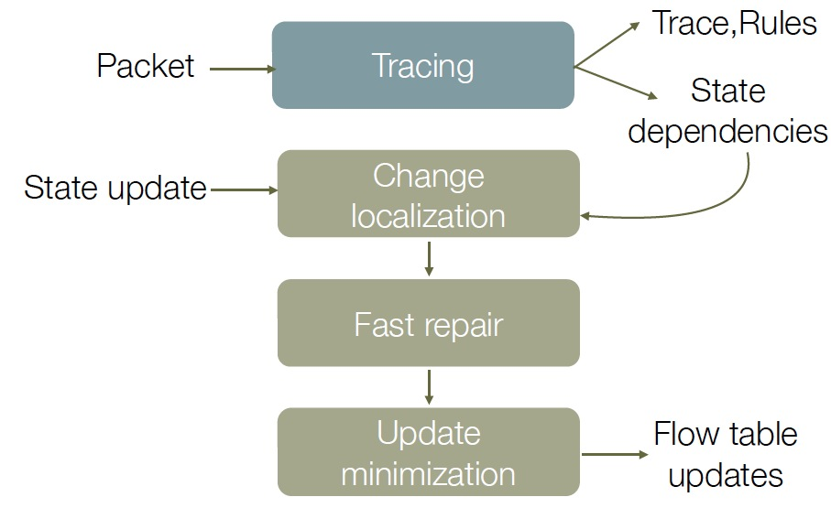
Maple/ASU Components

Slide 90
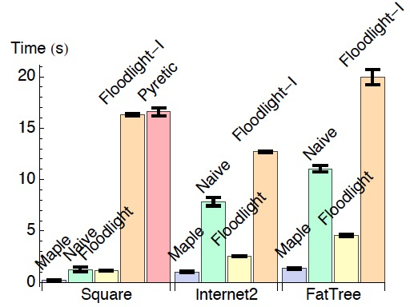
Evaluations: Time to Recover from Failures
Maple: 6x,2x,3x improvement over Floodlight!

Slide 91
Outline
What and why SDN?
Current SDN programming systems
Algorithmic SDN programming
Programming model
Maple/Basic (aka Maple 1.0)
Maple/auto-state-update (aka Maple 1.5)
Problems of Maple
Notes:
At a high level, abstraction is to hide issues that others do not want to or hard to do things.

Slide 92
Problems of Trace Tree
Latency: A reactive approach that waits for punted packets to begin unfolding the trace tree and generating rules
Quality: Compiles to a single flow table

Slide 93
Why is Multi-Table Important (Simple GBP)?
Map<MAC, ConditionSet> hostTable;
0. Route onPacketIn(Packet p) {
1. ConditionSet srcCond = hostTable.get( p.ethSrc() );
2. ConditionSet dstCond = hostTable.get( p.ethDst() );
3. if (srcCond != null && dstCond != null && pass(srcCond, dstCond) )
4. return pass;
5. else
return drop; }
Assume n hosts in hostTable
TT after pingall among the n hosts
ethSrc
Flow table from trace tree
a1
ethSrc | ethDst | Action
a₁ | a₁ | p₁
a₁ | a₂ | p₂
.. | … | …
a_{n} | a_{n} | p_{n2}
ethDst
ethDst
a1
an
a1
an
p1
pn
p
pn2
n² entries

Slide 94
More Efficient Multi-Table (2 Tables) Design
Table 1
Assume k condition possibilities.
ethSrc | Action
a₁ | reg_{srcCond}=y₁ jump 2
a₂ | reg_{srcCond}=y₂ jump 2
.. | …
a_{n} | reg_{srcCond}=y_{n} jump 2
otherwise | drop
Table 2
regs_{rcSw} | ethDst | Action
y₁ | a₁ | p_{1,1}
y₁ | a₂ | p_{1,2}
.. | … | …
y_{k} | a_{n} | p_{k,n}
otherwise |  | drop
n + kn entries

Slide 95
More Efficient Multi-Table (3 Tables) Design
Table 1
Assume k condition possibilities.
ethSrc | Action
a₁ | reg_{srcCond}=y₁ jump 2
a₂ | reg_{srcCond}=y₂ jump 2
.. | …
a_{n} | reg_{srcCond}=y_{n} jump 2
otherwise | drop
Table 3
reg_{srcCond} | regs_{dstCond} | Action
y₁ | y₁ | p_{1,1}
y₁ | y₂ | p_{1,2}
.. | … | …
y_{k} | y_{n} | p_{k,k}
otherwise |  | drop
Table 2
ethDst | Action
a₁ | reg_{dstCond}=y₁ jump 3
a₂ | reg_{dstCond}=y₂ jump 3
.. | …
a_{n} | reg_{dstCond}=y_{n} jump 3
otherwise | drop
2n + k² entries
Assume n = 4000, k = 100 n²: 1,000,000 = 1000K 2.5x n+kn: 4,000 + 400,000= 404K 22x
2n + k²: 8000 + 10,000 = 18K

Slide 96
Outline
What and why SDN?
Current SDN programming systems
Algorithmic SDN programming
Programming model
Maple/TT (aka Maple 1.0)
Maple/TT+auto-state-update (aka Maple 1.5)
Problems of Maple using trace tree
Magellan (aka Maple 2.0)
Notes:
At a high level, abstraction is to hide issues that others do not want to or hard to do things.

Slide 97
Magellan: Ideal Design Goal
Proactively, fully generate flow tables
Problem
Switch has limited computation model
Execution paths that lead to non-switch-implementable actions (e.g., state update) still need to punt
Non-compact mappable instructions need punt as well

Slide 98
An Example Non-Compact Mappable Instruction
blockPort = 22 // policy
servers = [A, B, C, D] // net func hostTable = {A:0,B:1,C:2,D:3} // netview
def onPacketIn(p): // policy+netfunc+netvw -> DP
if blockPort == p.tcp_dst: return drop
else: s = servers[p.ip_src % len(servers)]
return forward([hostTable[s]])

Slide 99
An Example Non-Compact Mappable Instruction
3 instead of 4 servers
blockPort = 22 // policy
servers = [A, B, C] // net func hostTable = {A:0,B:1,C:2,D:3} // netview
def onPacketIn(p): // policy+netfunc+netvw -> DP
if blockPort == p.tcp_dst: return drop
else: s = servers[p.ip_src % len(servers)]
return forward([hostTable[s]])
There is no compact representation of instruction pkt-attr % k, where there is no i. s.t. k = 2^{i}.

Slide 100
Magellan: Goal and Basic Ideas
Maximize flow table hit using minimal flow table size
Basic idea:
Trace tree is a mostly blackbox approach, while Magellan starts with the other extreme---a whitebox approach.

Slide 101
Magellan: Basic Ideas
Function f consists of a sequence of instructions I₁, I₂, …, I_{n}.
Each instruction I is a mapping from input variable states to output variable states
InVar(I)₁ | InVar(I)₂ | InVar(I)₃ | OutVar(I)
1 | 1 | 1 | OutVar(I)=Ins(1,1,1)
…
…

Slide 102
Example
Map<MAC, ConditionSet> hostTable;
0. Route onPacketIn(Packet p) {
1. ConditionSet srcCond = hostTable.get( p.ethSrc() );
2. ConditionSet dstCond = hostTable.get( p.ethDst() );
3. if (srcCond != null && dstCond != null && pass(srcCond, dstCond) )
4. return port1;
5. else
return drop; }
Map<MAC, ConditionSet> hostTable;
Route onPacketIn(Packet p) {
I1. ConditionSet srcCond = hostTable.get( p.ethSrc() );
I2. ConditionSet dstCond = hostTable.get( p.ethDst() );
I3. branch [srcCond != null && dstCond != null && pass(srcCond, dstCond) ] I4 I5
I4. return port1
I5. return drop

Slide 103
Example
Map<MAC, ConditionSet> hostTable;
Route onPacketIn(Packet p) {
I1. ConditionSet srcCond = hostTable.get( p.ethSrc() );
I2. ConditionSet dstCond = hostTable.get( p.ethDst() );
I3. branch [srcCond != null && dstCond != null && pass(srcCond, dstCond) ] I4 I5
I4. return port1
I5. return drop
I1
I2
I3
p.ethSrc | Action
1 | srcCond₁ jump I2
2
...
2⁴⁸ | srcCond_{2^48} jump I2
p.ethDst | Action
1 | dstCond₁ jump I3
2
...
2⁴⁸ | dstCond_{2^48} jump I3
srcCond | dstCond | Action
srcCond₁ | dstCond₁ | jump I4
… |  | jump I5
…

Slide 104
Problem and Improvement the Initial Approach
Table construction does not consider available state info: only the n values in current hostTable state are needed. Hence table size should be n+1, not 2⁴⁸
We say I1 is a compact-mapable (CM) statement.
I1
p.ethSrc | Action
1 | srcCond₁ jump I2
2
...
2⁴⁸ | srcCond_{2^48} jump I2
p.ethSrc | Action
a₁ | srcCond_{a1} jump I2
a₂
.. | …
a_{n} | srcCond_{an} jump I2
otherwise | srcCond=null
I1. ConditionSet srcCond = hostTable.get( p.ethSrc() );

Slide 105
More Examples of CM Statements
y = p.ethSrc() > m
p.ethSrc | Action
1 | y=false
...
m | y=false
m+1 | y=true
… | …
2⁴⁸ | y=true
p.ethSrc | Action
… | …
y = p.ethSrc != p.ethDst
p.ethSrc | p.ethDst | Action
1 | 1 | y=false
1 | 2 | y=true
... | ... | …
2⁴⁸ | 2⁴⁸ | y=true
p.ethSrc | p.ethDst | Action

Slide 106
CM Propagation through Data-Flow Analysis
Instructions
Map<MAC, ConditionSet> hostTable;
Route onPacketIn(Packet p) {
I1. ConditionSet srcCond = hostTable.get( p.ethSrc() );
I2. ConditionSet dstCond = hostTable.get( p.ethDst() );
I3. branch [srcCond != null && dstCond != null && pass(srcCond, dstCond) ] I4 I5
ethSrc | Action
A | Reg1 = 01; jump T2
ethDst | Action
B | Reg2 = 02; jump T3
ethSrc
ethDst
I1 (hostTable)
I2 (hostTable)
srcCond
dstCond
Limited by hostTable.values()
Reg1 | Reg2 | Action
01 | 02 | route
I3
route
106

Slide 107
CM Propagation through Data-Flow Analysis
Map<MAC, ConditionSet> hostTable;
Route onPacketIn(Packet p) {
I1. ConditionSet srcCond = hostTable.get( p.ethSrc() );
I2. ConditionSet dstCond = hostTable.get( p.ethDst() );
I3. branch [srcCond != null && dstCond != null && pass(srcCond, dstCond) ] I4 I5
I4. return port1
I5. return drop
I1
I2
I3
p.ethSrc | Action
a₁ | srcCond_{a1} jump I2
a₂
...
a_{n} | srcCond_{an} jump I2
p.ethDst | Action
a₁ | dstCond_{a1} jump I3
a₂
...
a_{n} | dstCond_{an} jump I3
srcCond | dstCond | Action
srcCond₁ | dstCond₁ | y=true; jump I4
… |  | y=false; jump I5
…
Only output in I1/I2 tables are needed as input to I3 table input

Slide 108
Map -> Map-Explore
Map<MAC, ConditionSet> hostTable;
Route onPacketIn(Packet p) {
I1. ConditionSet srcCond = hostTable.get( p.ethSrc() );
I2. ConditionSet dstCond = hostTable.get( p.ethDst() );
I3. branch [srcCond != null && dstCond != null && pass(srcCond, dstCond) ] I4 I5
I4. // path = shortest path alg to compute route // from p.ingressSw to ethDst
return path
I5. return drop

Slide 109
Magellan: Optimizations
One table per instruction may generate too many tables. One can merge tables from multiple instructions.
Map<MAC, int> table;
Route onPacketIn(Packet p) {
I1. int val1 = table.get( p.ethSrc() );
I2. int val2 = val1 * val1;
I3. branch [val2 > 10] I4 I5
I4. return pass
I5. return drop
Consider I2, which follows I1. If input(I2)=input(I1,I2), then merge them will not increase table size.
I2 can merge w/ I1.

Slide 110

Magellan Main Components and Workflow
onPacket
static compile
time
Compile
IR
Analyze& Design
Table Graph
Code Gen
dynamic run
time
Explorer Graph
Explorer
P4 Pipeline
DB
Northbound
FlowRule Compile
Rules
Packets Notifications
Openflow switch
P4 switch

Slide 111

Thank You

Slide 112





A Simple ScienceNET Example Controller
badSrc = 100 // policy topo = {…} // netview
def onPacketIn(p): // policy+netvw->DP
if badSrc == p.ip_src: return drop
else: return mySNAlg(topo, p.ip_dst)
def mySNAlg(topo, dst-ip):
if dtn.ip == dst-ip: return alg1(topo, dst-ip)
else: return alg2(topo, dst-ip)
D (dtn)
A
B

Slide 113
End Result: Flow Table
Priority | ip_src | ip_dst | Action
1 | 100 | * | drop
0 | * | A | out 2
0 | * | B | out 2
0 | * | D | out 1
Table has many wildcard entries => inefficient.
D
A
B

Slide 114
More Efficient Flow Tables using OF 1.3
Table 1
ip_src | Action
100 | drop
default | Jump Table 2
Table 2
ip_dst | Action
A | out 2
B | out 2
D | out 1
D
A
B

Slide 115
Software Architecture w/ Network Program Lang
Automatic generate memorization tables; capture (closure) and maintain consistency w/ state
Admin/UI
Service/App
ACL
L3/2 VPN
Service Chain
Shortest Path
AbstractViews
DeviceModel
fACL
fL3/2 VPN
fService Chain
f…
DeviceModel
PhysicalView
Packet-Processor-Independent Processing
DeviceModel
Southbound
Infrastructure Layer
115

Slide 116
Status
Two implementations
Maple
A reactive (dynamic-tracing) blackbox approach that demonstrated the basic feasibility of automating programming
Code will become openly available in OpenDaylight as part of CCIIE
Test deployment at Yale ScienceNet
Magellan (aka Maple 2.0)
A general view that a centralized algorithmic policy (AP) is a stream processing function
A whitebox approach where distributed network flow tables are memorization tables implementing algorithmic policies
In active design and implementation phase

Slide 117
Softwarization of Network Programming: Key Next Steps
High-level, datapath oblivious, composable programming models
Go beyond reactive programming to proactive, learning programming
- Compiler/runtime/libraries to substantially simplify network softwarization programming
- Stabilize hardware-friendly, software-integrated data path
Notes:
http://events.linuxfoundation.org/sites/events/files/slides/odls15_herrell.pdf

